Slide 1


Double degree with Cranfield University

Slide 2


Slide 3
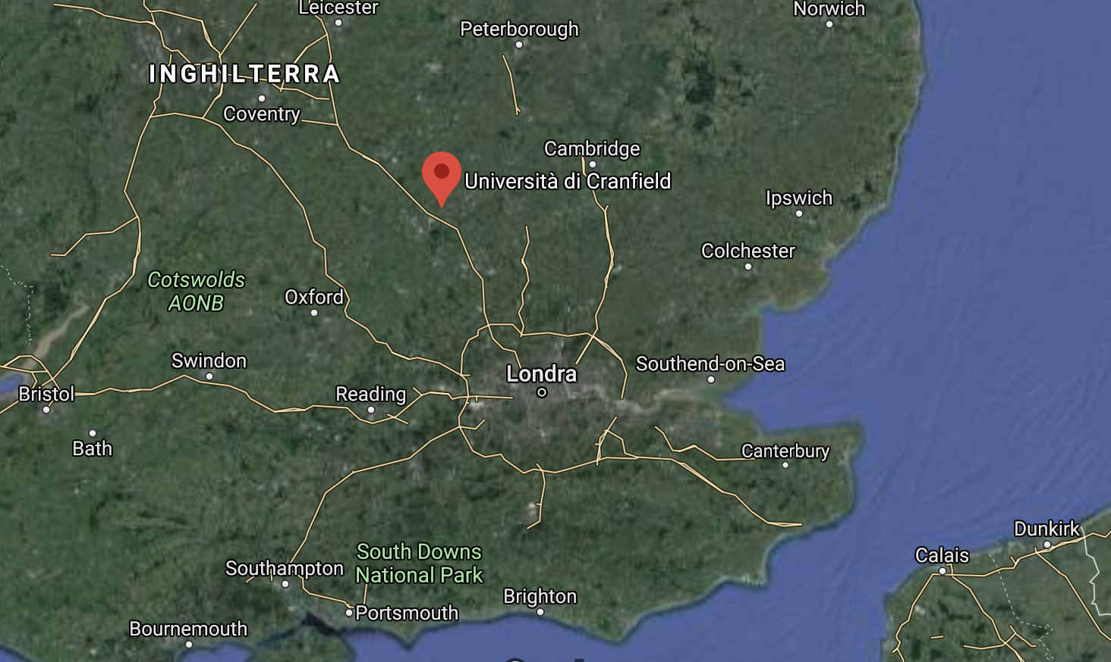
Where is?

Slide 4
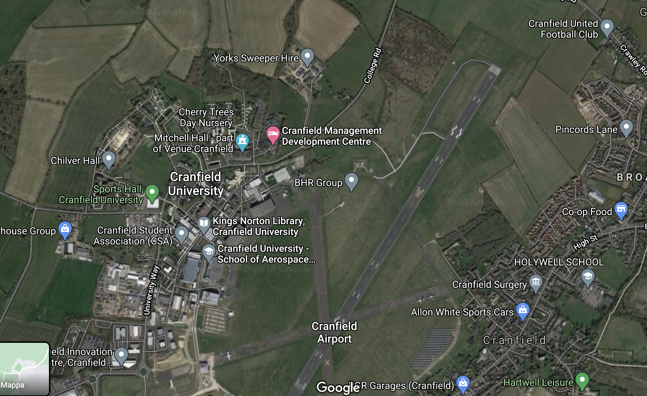
A closer look

Slide 5

A closer look

Slide 6
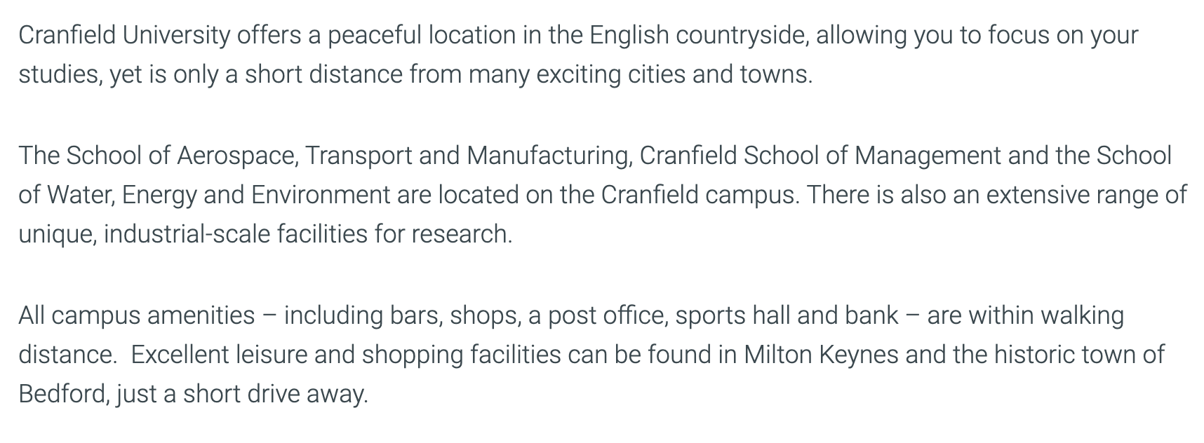

Slide 7
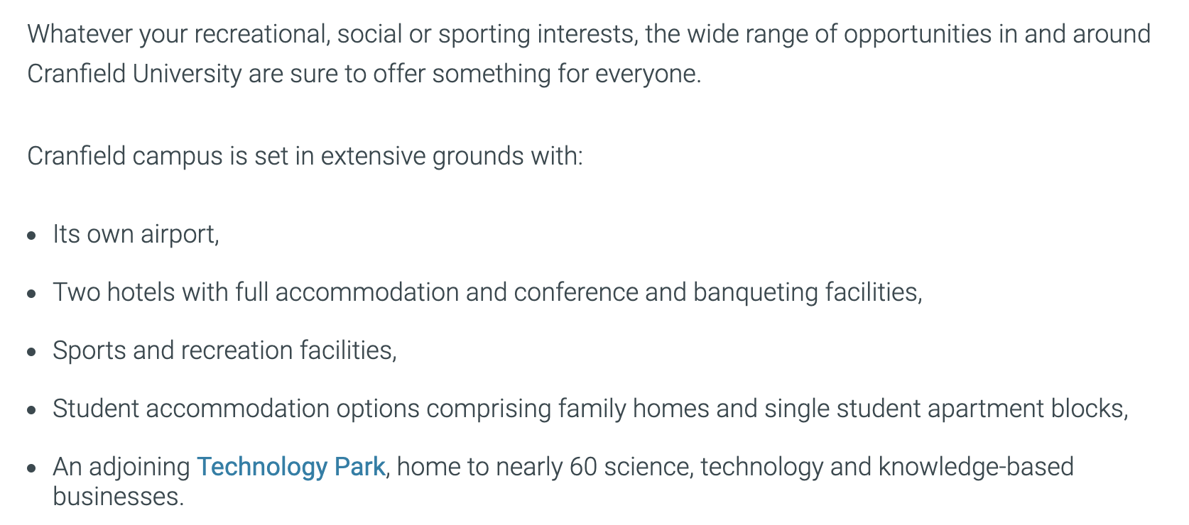

Slide 8
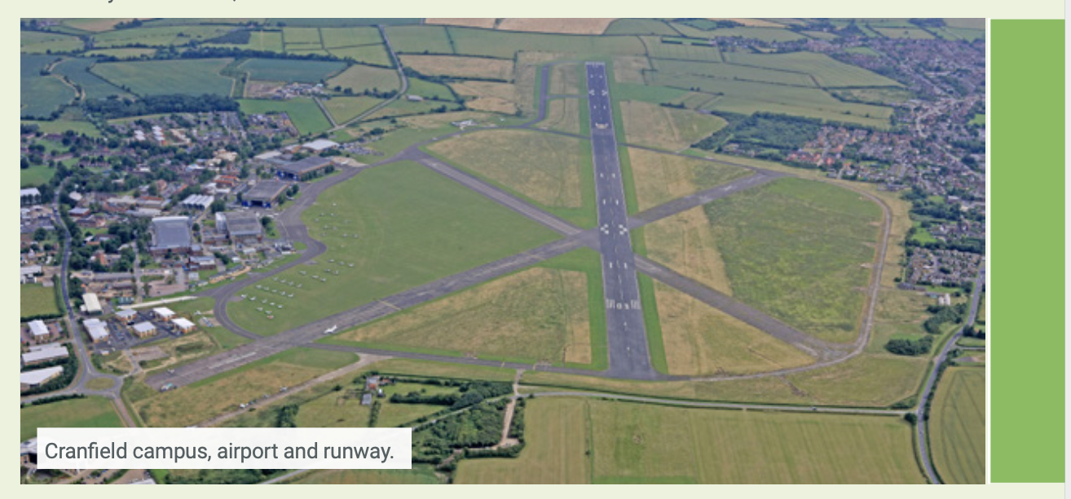

Slide 9
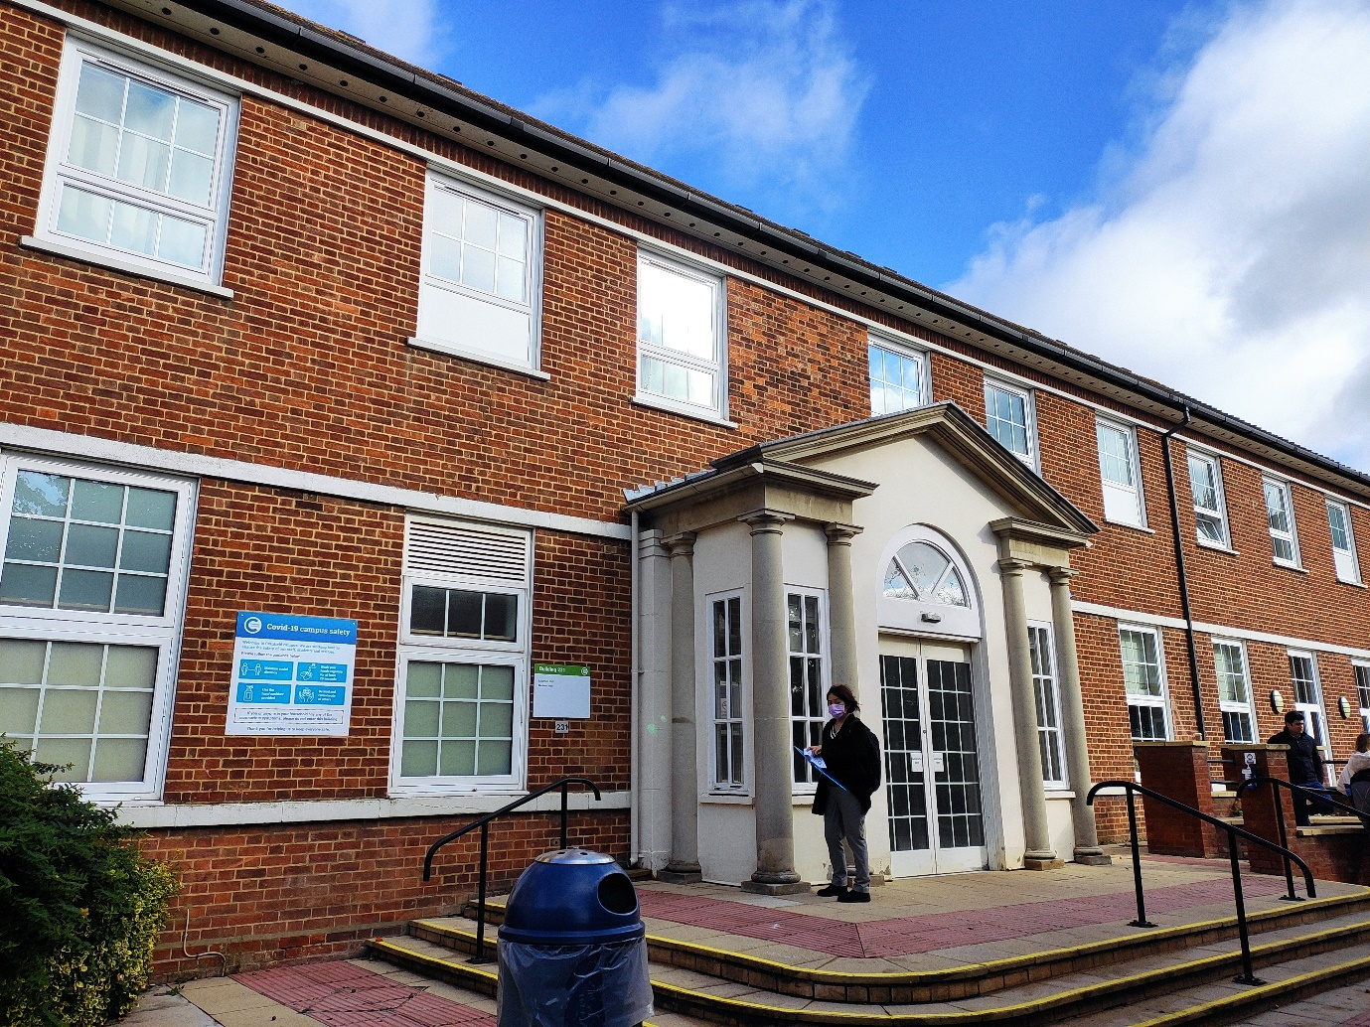
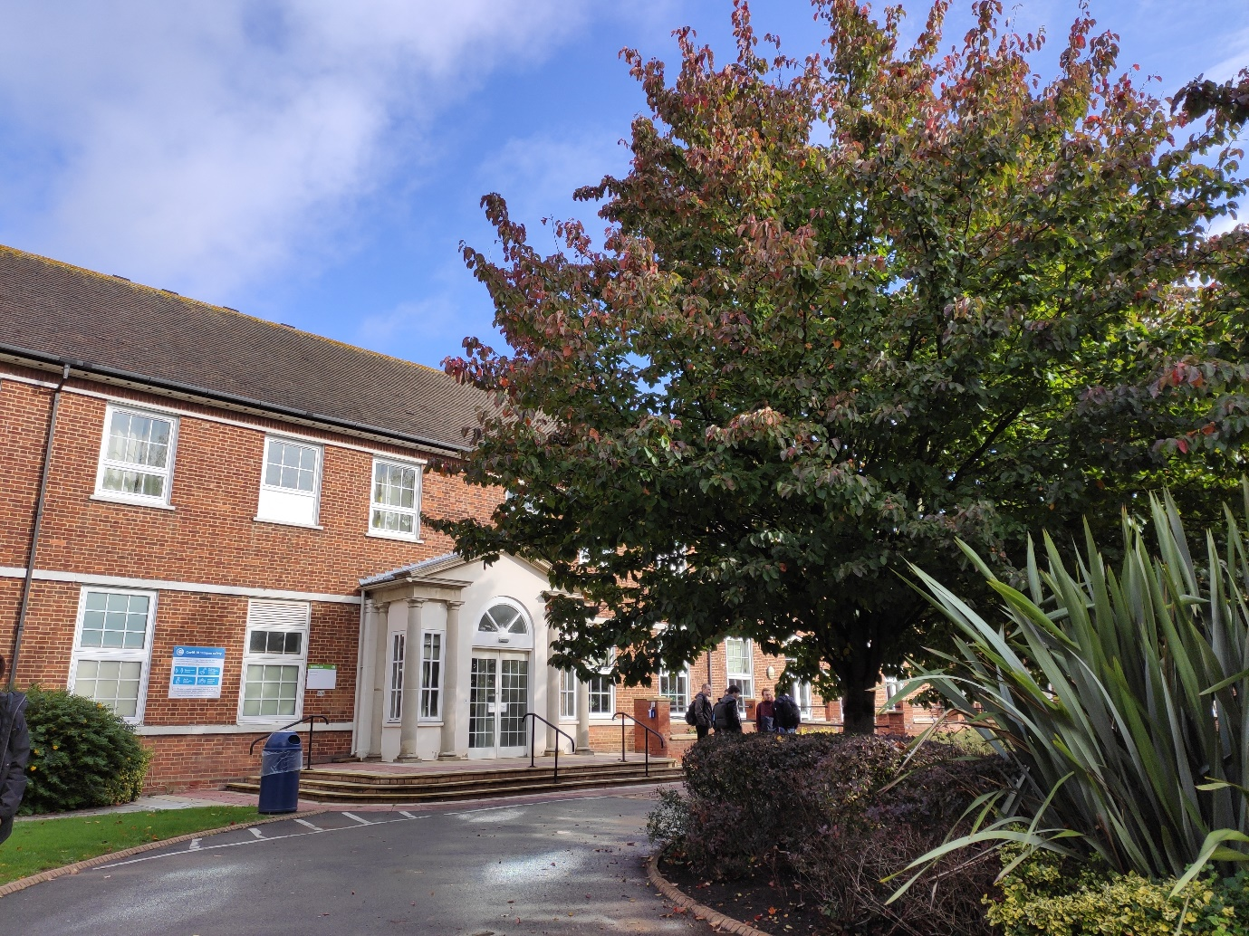
Mitchell Hall (sede di alloggi e di aule per le lezioni)

Slide 10
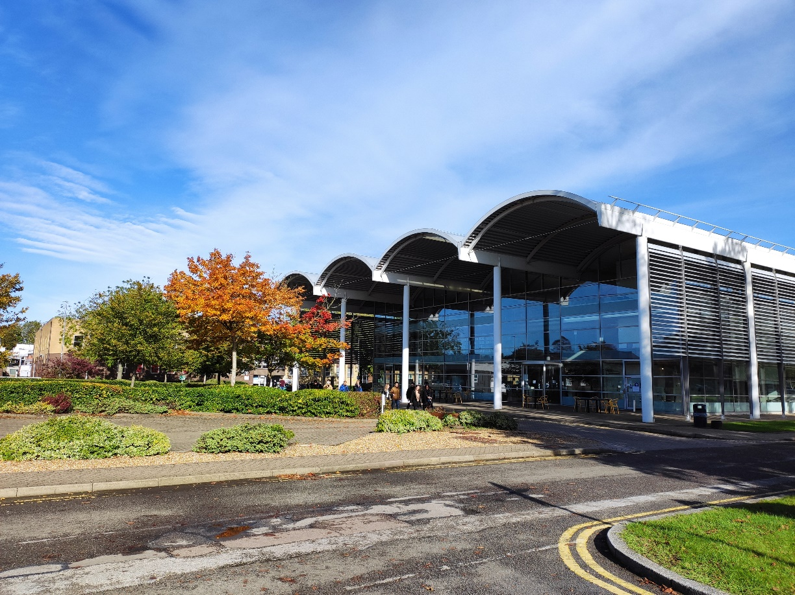
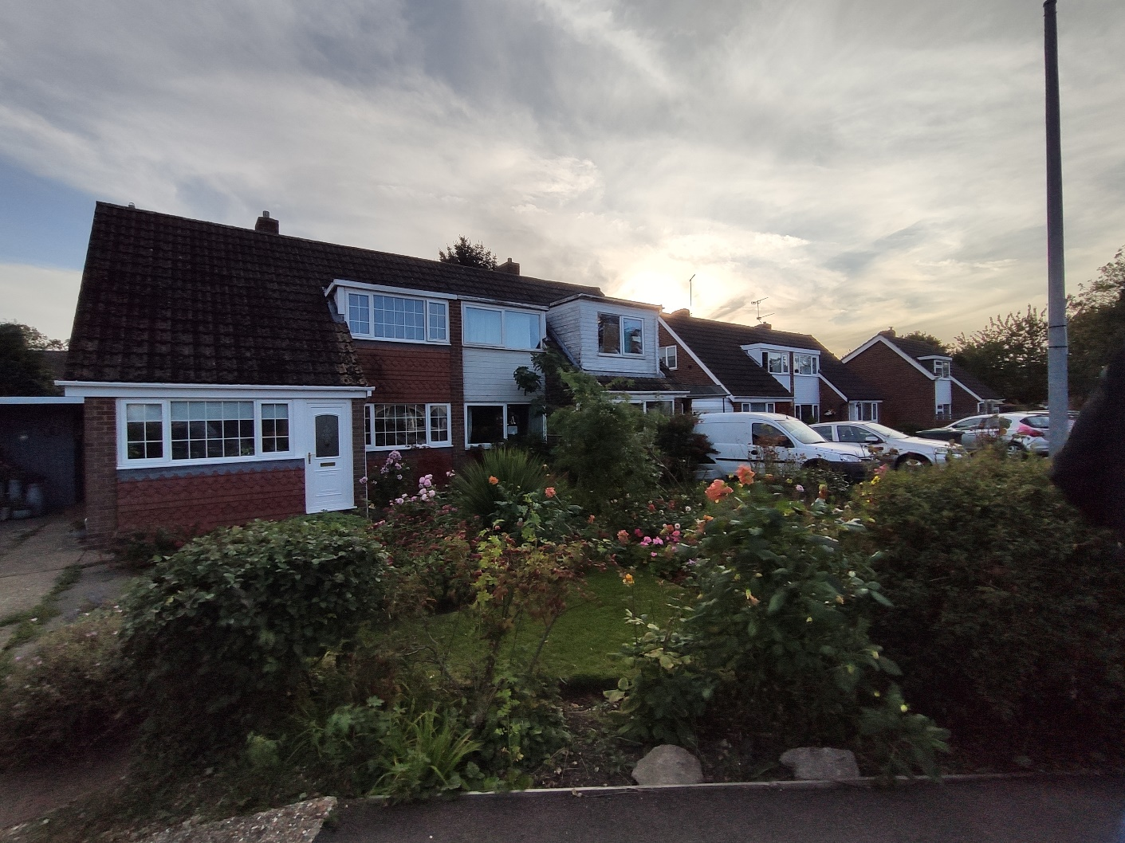
Biblioteca – Kings Norton Library
Vicinato inglese

Slide 11
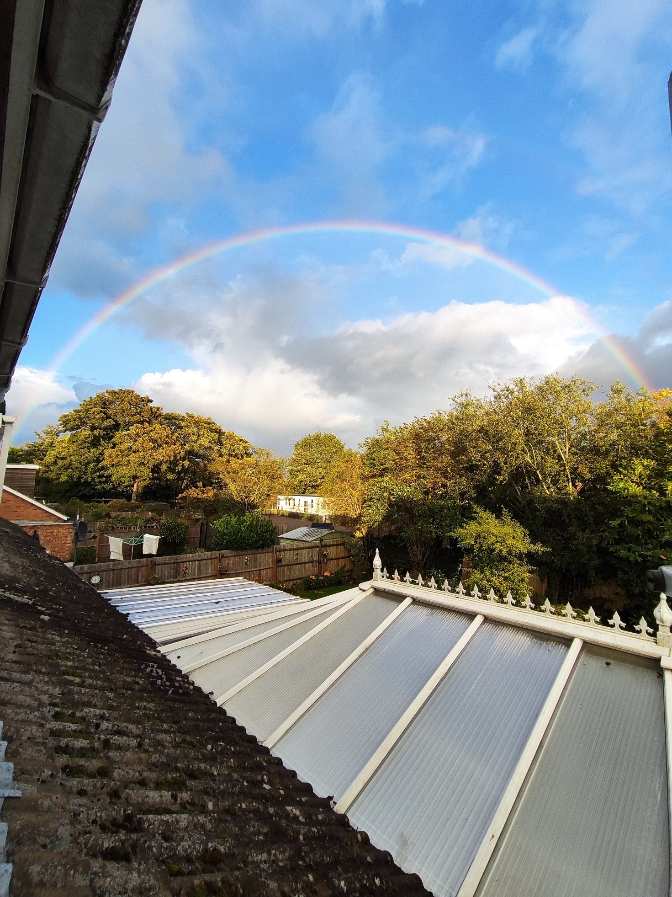
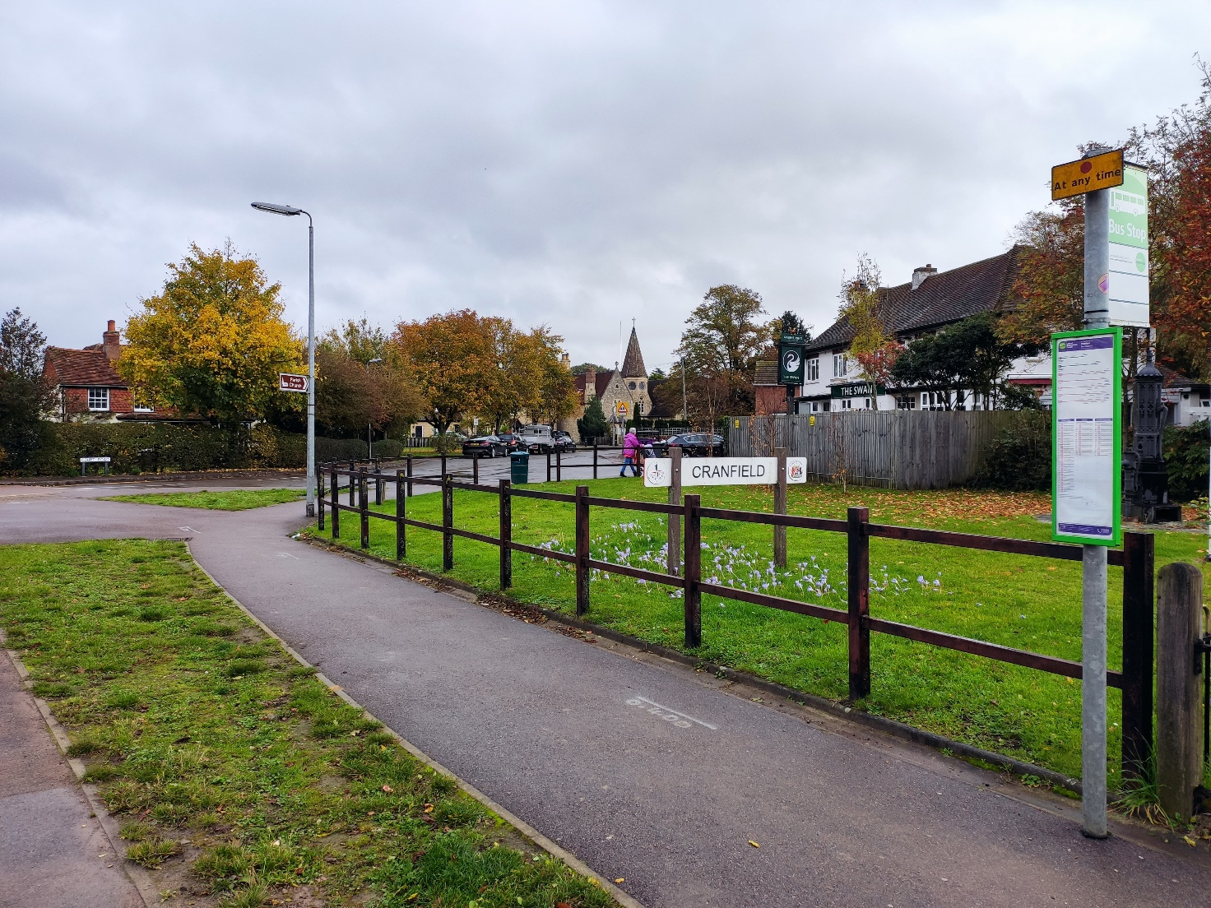
Fermata del bus

Slide 12
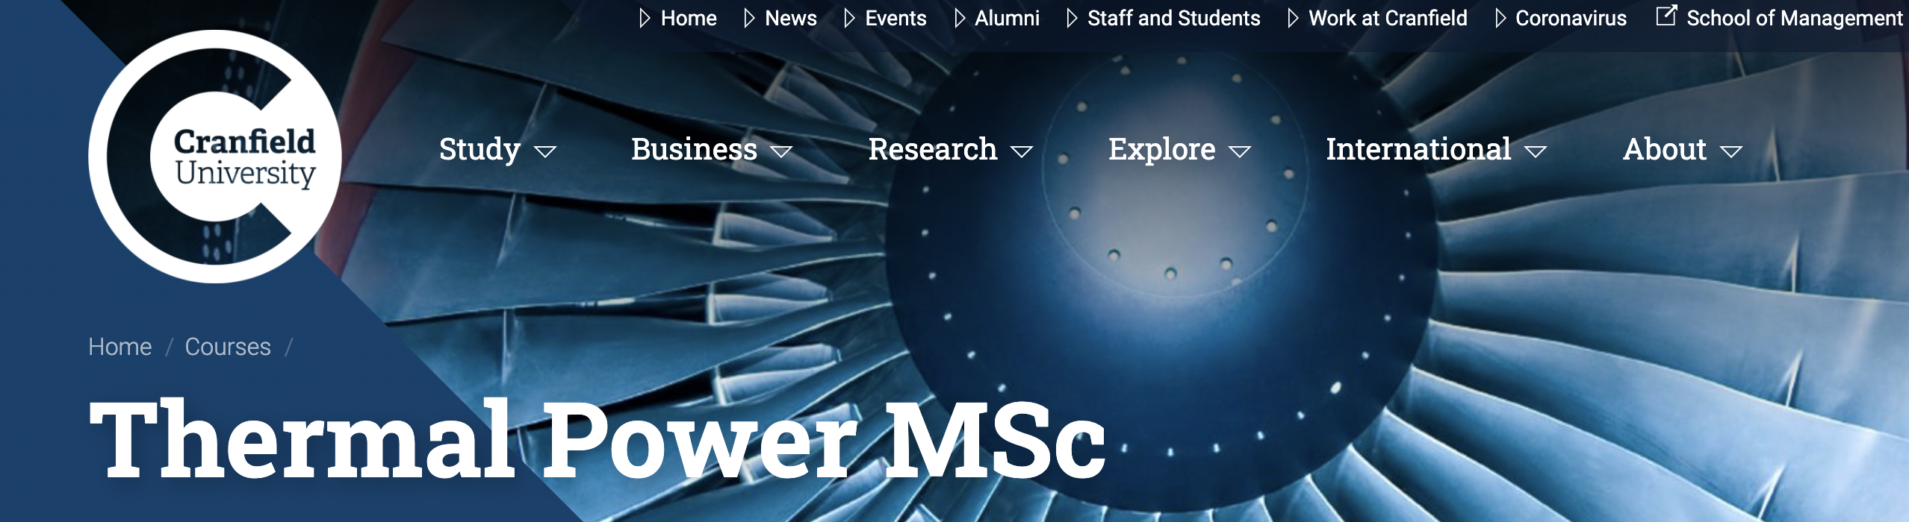
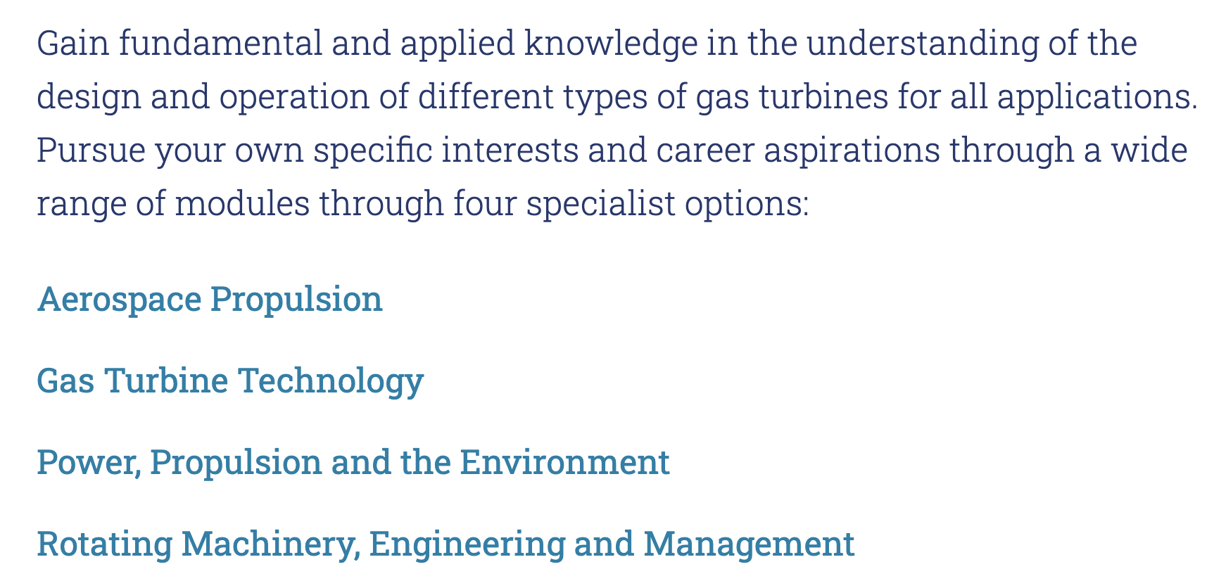

Slide 13
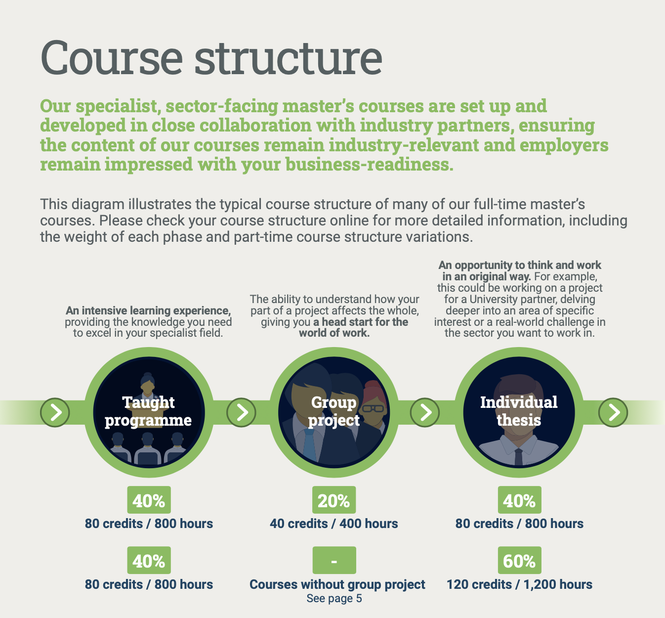

Slide 14
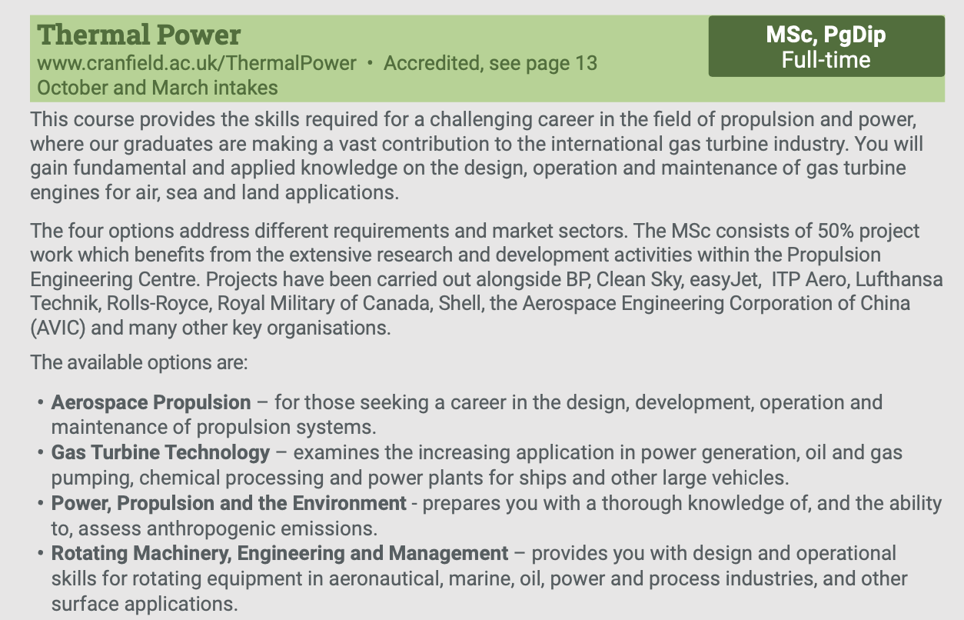

Slide 15
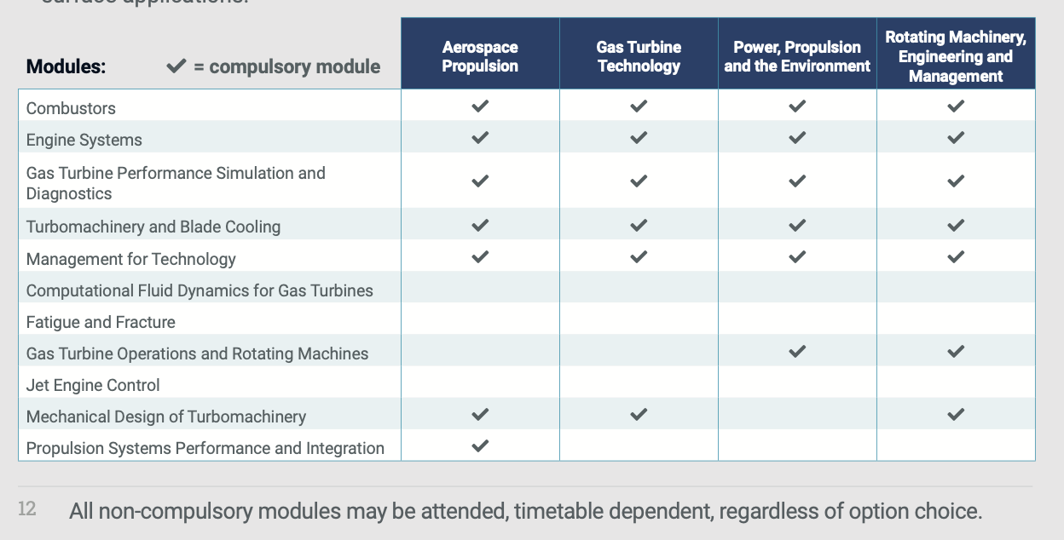

Slide 16


Slide 17
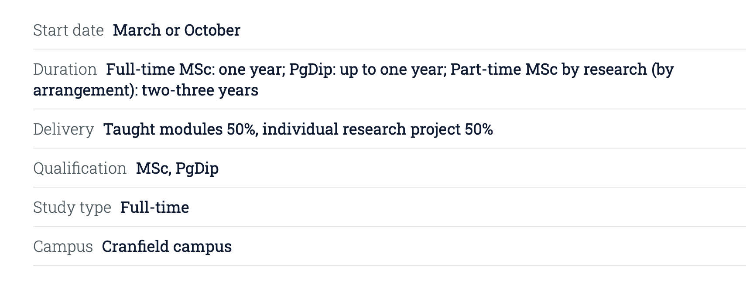

Slide 18
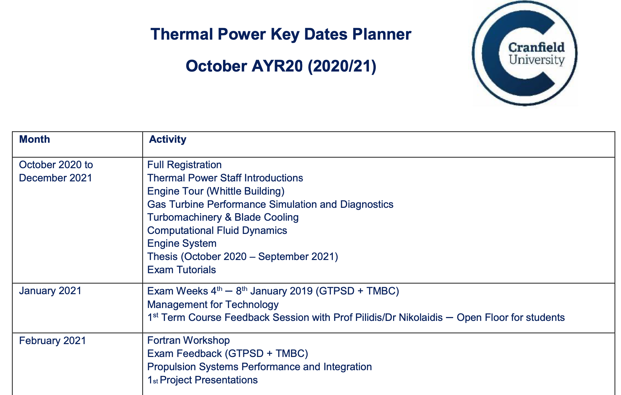

Slide 19
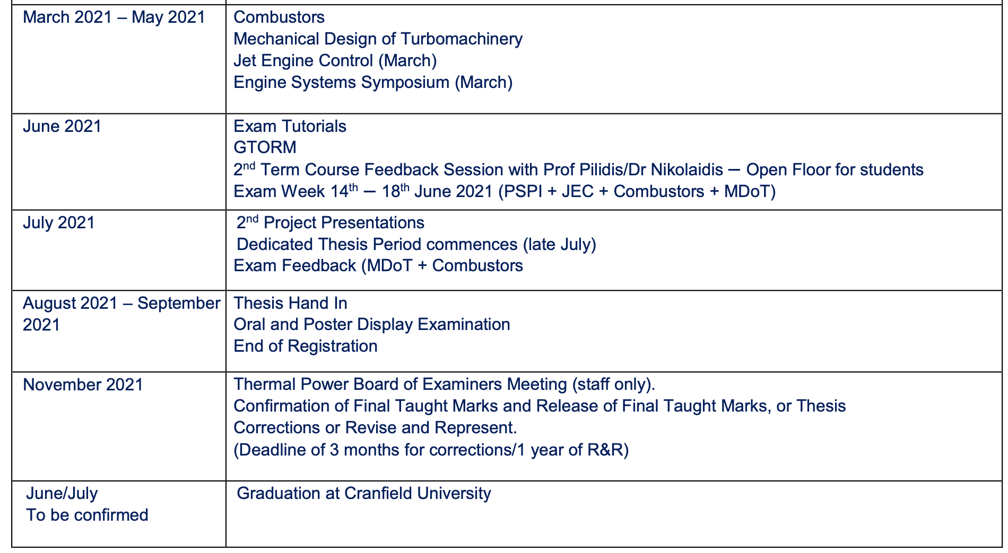

Slide 20
Scholarship for «Thermal power MSc» (Full £ 24000):
March 2021 - one scholarship without fees, two with fees at £5000
Oct 2021 - one scholarship without fees, one with fees at £5000 and one with fees at £10000
March 2022 - one scholarship without fees, one with fees at £5000 and one with fees at £10000

