Slide 1


Slide 2
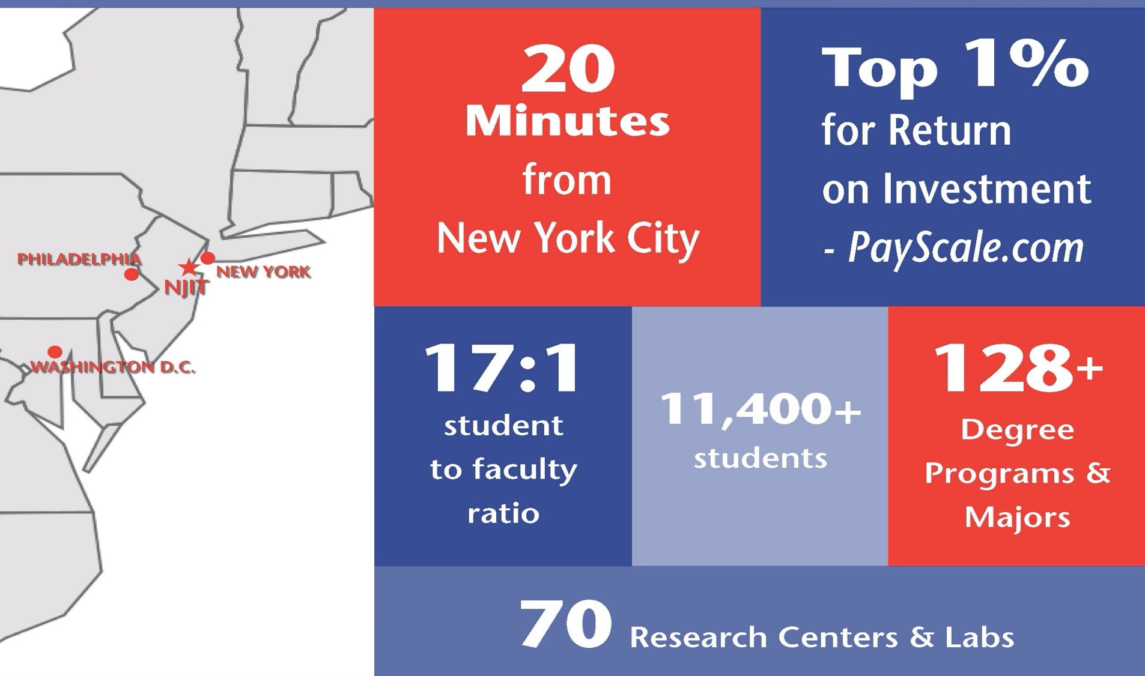

Slide 3
Top 10% nationally for Return on Investment (Bloomberg Businessweek)
Awards and Recognition
#97 National Ranking (U.S. News & World Report)
# 329 THE US UNIVERSITY RANKING
(Times Higher Education University Ranking)
Computer science program #2 in the World
(Center for world university rankings)
Top Graduate School of Engineering
(U.S. News & World Report)
Top 50 among colleges without a medical school for research expenditures and top 10 among universities whose main research is in engineering
(National Science Foundation)

Slide 4
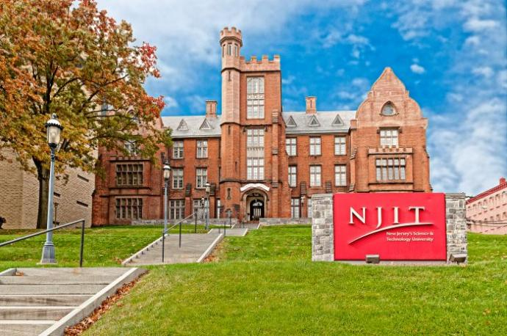
Main features
State-of-the-art facilities on a 45-acre campus in Newark, New Jersey
Research expenditures exceeding $110 million
Over 2500 international students
Easy access to New York City via public transportation

Slide 5

New to NJIT
Wellness and Events Center
  $100 million multipurpose athletic facility. The key component is an arena seating 3,500 fans for the institute’s highest-profile sport, men’s college basketball.

Slide 6






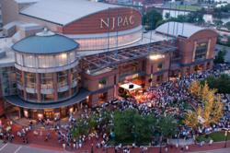

Great Location

Slide 7

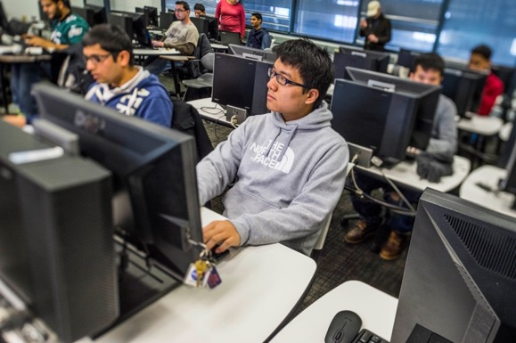
Newark College of Engineering
Biomedical Engineering (M.S. & Ph.D.)
Chemical Engineering (M.S. & Ph.D.)
Civil Engineering (M.S. & Ph.D.)
Computer Engineering (M.S. & Ph.D.)
Critical Infrastructure Systems (M.S.)
Electrical Engineering (M.S. & Ph.D.)
Engineering Management (M.S.)
Environmental Engineering (M.S. & Ph.D.)
Healthcare Systems Management (M.S.)
Industrial Engineering (M.S. & Ph.D.)
Internet Engineering (M.S.)
Manufacturing Engineering (M.S.)
Mechanical Engineering (M.S. & Ph.D.)
Occupational Safety & Health (M.S.)
Pharmaceutical Engineering (M.S.)
Pharmaceutical Systems Management (M.S.)
Power & Energy Systems (M.S.)
Telecommunications (M.S.)
Transportation Engineering (M.S. & Ph.D.)

Slide 8













Employers of NJIT Graduates
AT&T
Broadcom
Cisco Systems, Inc.
Colgate-Palmolive
Forbes.com
IBM
L’Oreal USA
NJTransit
Qualcomm
Schneider Electric
Stryker Orthopedics
TATA Consultancy Services
UBS Financial Services, Inc.

Slide 9
Double Degree Structure
Poliba (78 ECTS)
  Lectures (72 ECTS)
  English II (3 ECTS)
  Master thesis (6 ECTS)
NJIT (42 ECTS) (+ 18 ECTS double counted)
  1° semester
    5 courses (3 credits each) + master project (1.5 credits)*
  2° semester at Poliba
    1 on-line course (3 credits) + master project (1.5 credits)*
  or 2° semester at NJIT
    1 course (3 credits) + master project (1.5 credits)*
*la tesi è suddivisa sui due semestri

Slide 10
Requirements
Admission requirements
  Enrollment in M. Sc. Management Engineering
  At least 18 ECTS at the time of application and 48 ECTS before the departure to the US
  Language certificate: at least B2 level
  VISA
Learning agreement
  The student must prepare a plan of didactic activity (learning agreement), using the ERASMUS+ learning agreement format
  It must be coordinated with the program coordinator and approved by the DMMM Board

Slide 11
PoliBa Course | NJIT Course Equivalent
Assembly and Disassembly Processes | MNE 654. Design for Manufacturability
Continuous Improvement of Sustainable Manufacturing | IE 673. Total Quality Management (core course)
E-Business Models and Business Intelligence | MRKT 645. Internet Marketing Strategy
Information Systems | MIS 645. Information Systems Principles (core course)
Lean Production and Supply Chain Management | IE 659. Supply Chain Engineering
Management Accounting | ACCT 615. Management Accounting (core course)
Strategy and Organization | HRM 601. Organizational Behavior (core course)
Supply Chain Management | IE 659. Supply Chain Engineering
Systems Analysis and Simulation | IE 621. Systems Analysis and Simulation
Finance and Business Planning | FIN 610. Global Macro Economics
Industrial Logistics | EM 640. Distribution Logistics
Innovation Economics and Management | MGMT 620. Management of Technology
Operations Management | EM 602. Management Science (core course)

Slide 12
Transcript of records
Transcript of records
  At the end of the period NJIT provides a transcript of records to certify the student credits
  3 courses (6 ECTS each) at the Politecnico di Bari will be transferred with 9 Credits to NJIT
Grading System
NJIT grade | Significance | Points | Poliba grade
A = 4.0 | Excellent | 93-100 | 30 – 30 e lode
B+ = 3.5 | Good | 84-92 | 27-29
B = 3.0 | Acceptable | 76-83 | 24-26
C+ = 2.5 | Marginal Performance | 68-75 | 21-23
C = 2.0 | Minimum Performance | 60-67 | 18-20

Slide 13
Tuition and costs
Tuition and fees
  US $ 16.000 (full-time student)
Additional costs:
  lodging/housing (on-campus to the extent available, or off-campus)
  food (on-campus meal plans or food allowance)
  health insurance fees
  transportation;
  use of refectories and canteens;
  purchase of textbooks and other instructional materials and study aids

Slide 14


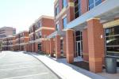

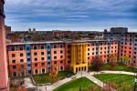
On - Campus Housing Options
Almost 2,000 students, and nearly 50 percent of first-year students, live on NJIT’s campus in 13 residence communities.
All residence rooms are fully furnished, air-conditioned, wireless and wired for Internet and cable TV. Each residence community has common areas and facilities including: study space, community kitchens, laundry rooms, recreational game rooms & lounges, and snack and beverage machines.

Slide 15
Applications and Contacts
Academic Program coordinators
  Prof. Ilaria Giannoccaro, DMMM, PoliBa
  Prof. Layek Abdel Malek, Department of Mechanical and Industrial Engineering, NJIT
  Applications
  Autumn: End of May
  Spring: Third week of October

